Slide 1

Data-Intensive Distributed Computing
CS 451/651 (Fall 2018)
Part 1: MapReduce Algorithm Design (2/4)
September 11, 2018
Jimmy Lin
David R. Cheriton School of Computer Science
University of Waterloo
These slides are available at http://lintool.github.io/bigdata-2018f/
This work is licensed under a Creative Commons Attribution-Noncommercial-Share Alike 3.0 United States See http://creativecommons.org/licenses/by-nc-sa/3.0/us/ for details

Slide 2

RTFM you must

Slide 3
Agenda for Today
Why big data?
Hadoop walkthrough

Slide 4
Why big data?
Data Science
Tools
This Course
Analytics Infrastructure
Execution Infrastructure
“big data stack”

Slide 5
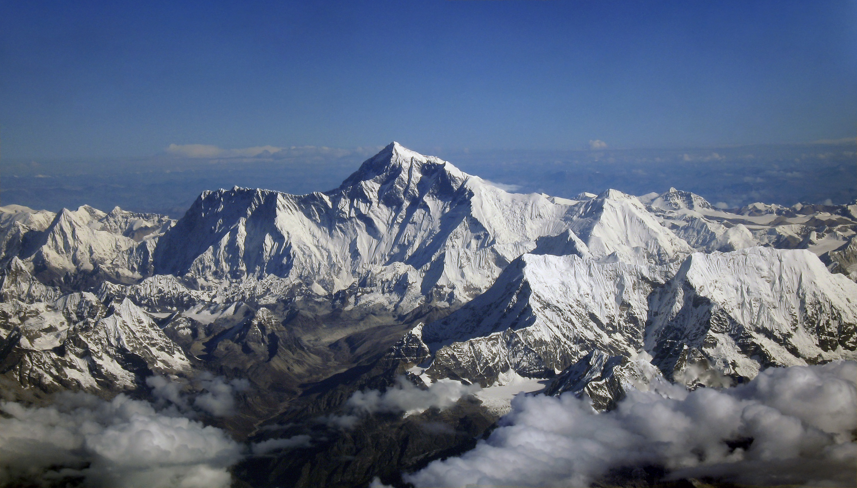
Why big data?
Science
Business
Society
Source: Wikipedia (Everest)

Slide 6
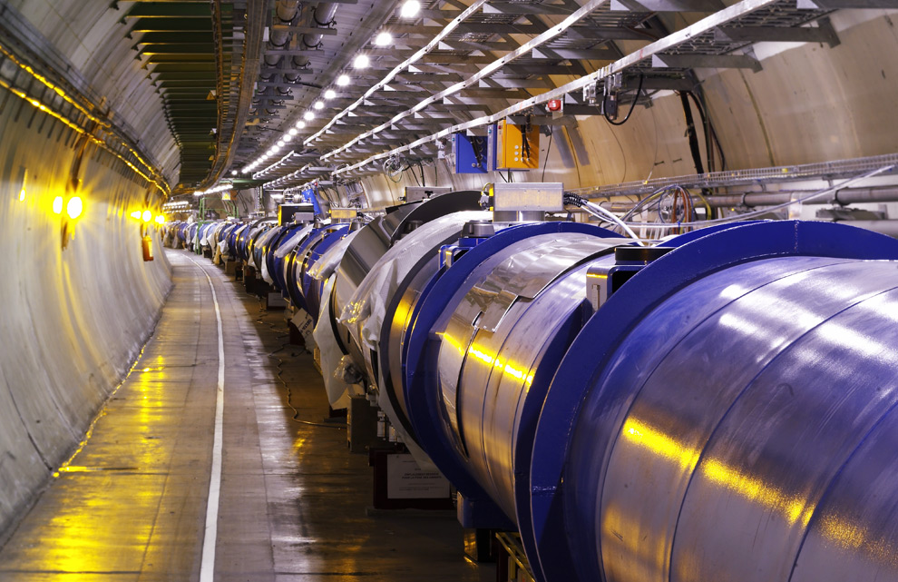
Science
Emergence of the 4th Paradigm
Data-intensive e-Science
Maximilien Brice, © CERN
Notes:
By the time it shuts down in 2011, the CERN collider should have amassed about 20 times as much data as it now has. (NYTimes article, “Trillions of Reasons to Be Excited”, 11/1/2010)

Slide 7
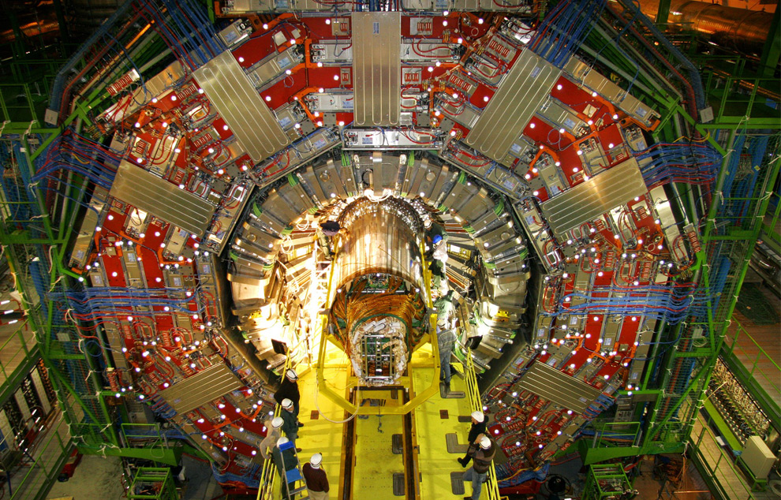
Maximilien Brice, © CERN

Slide 8
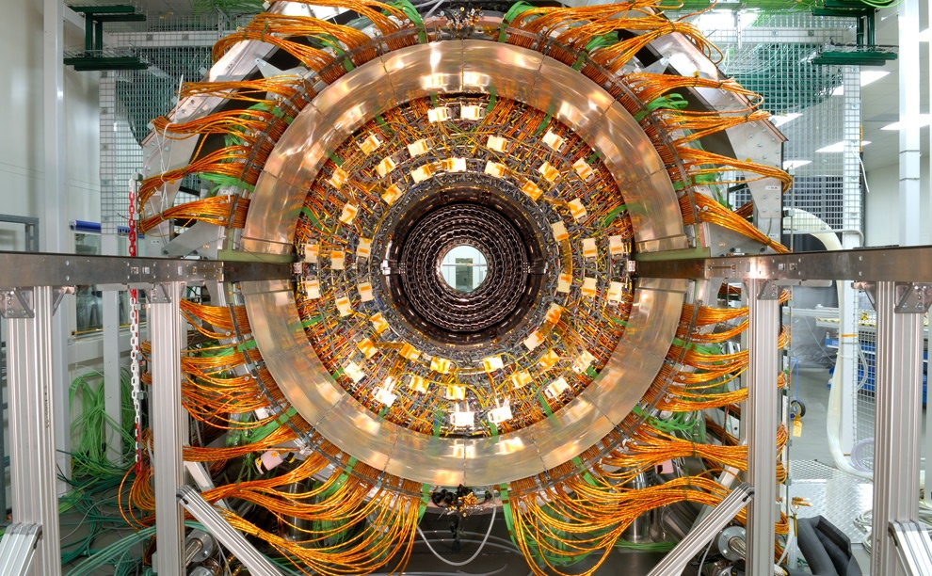
Maximilien Brice, © CERN

Slide 9
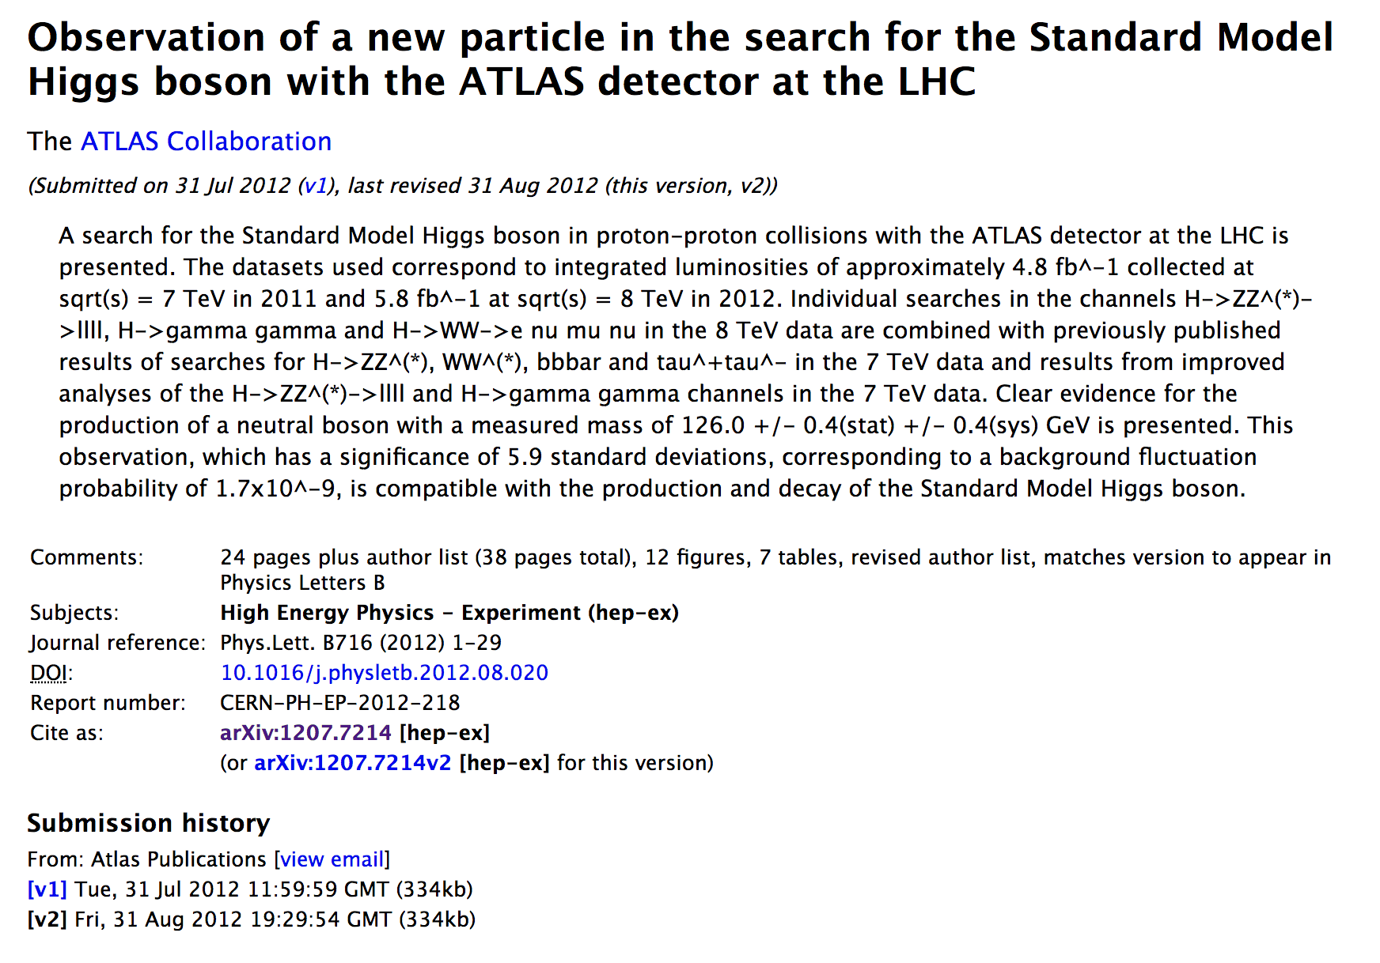

Slide 10
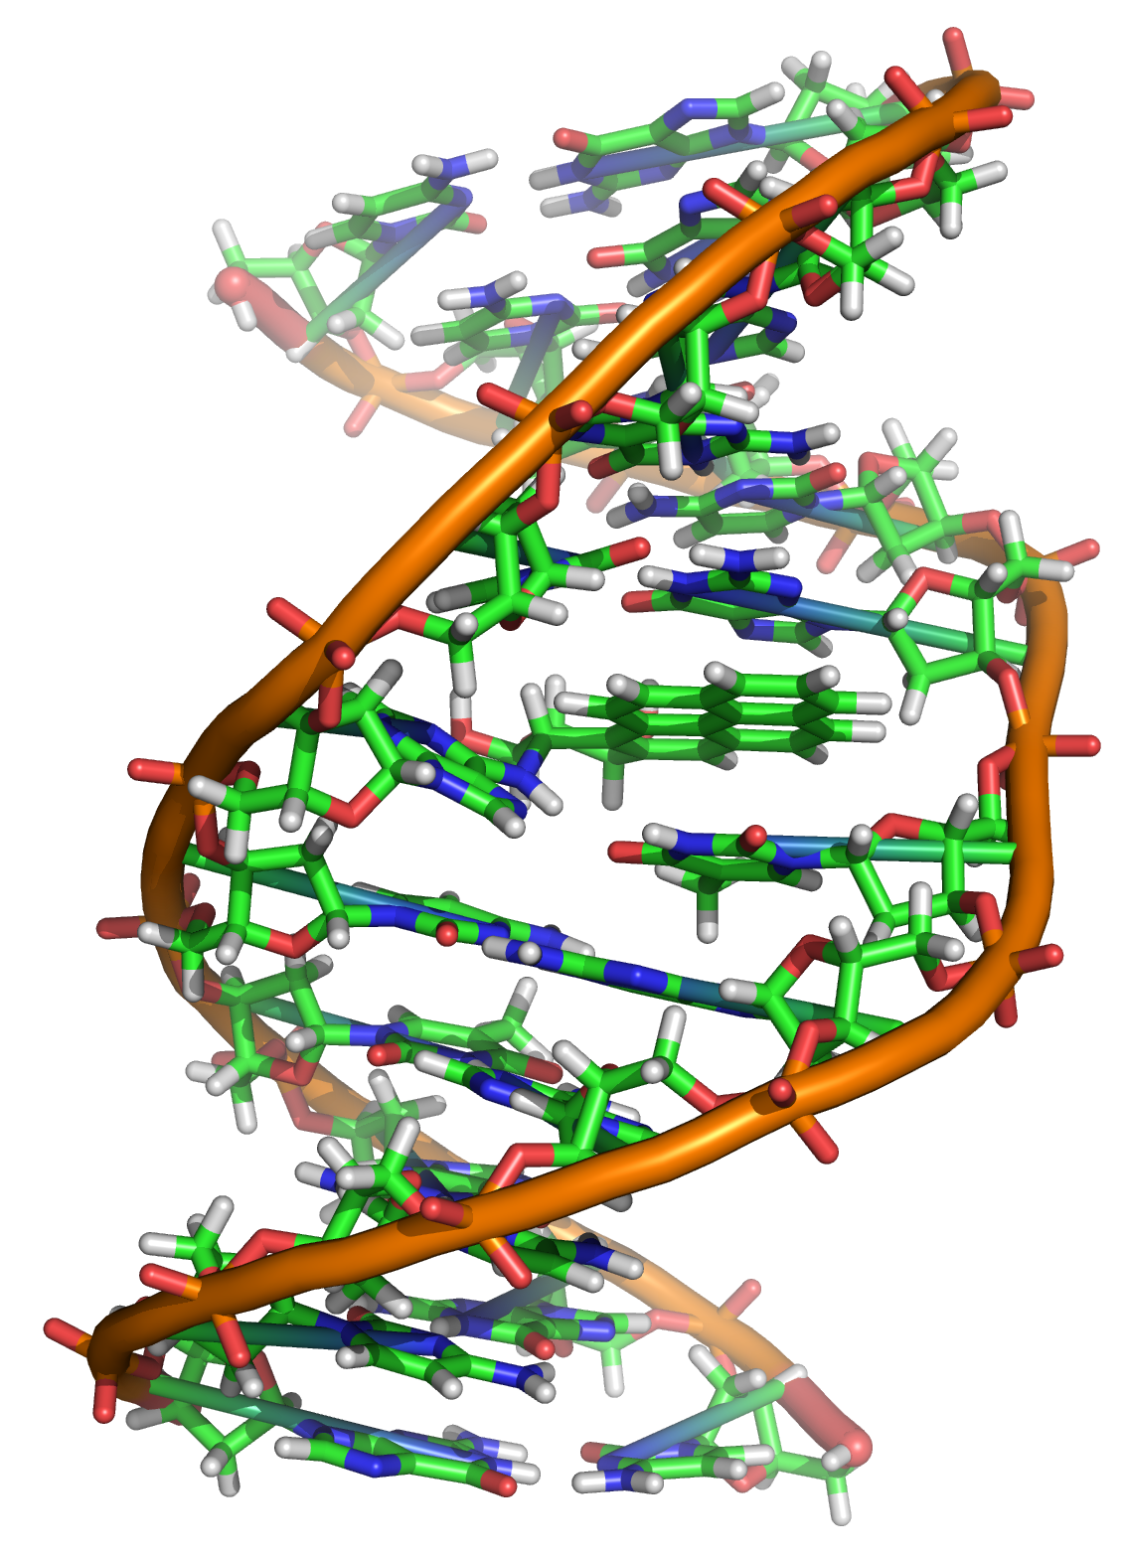
Source: Wikipedia (DNA)

Slide 11

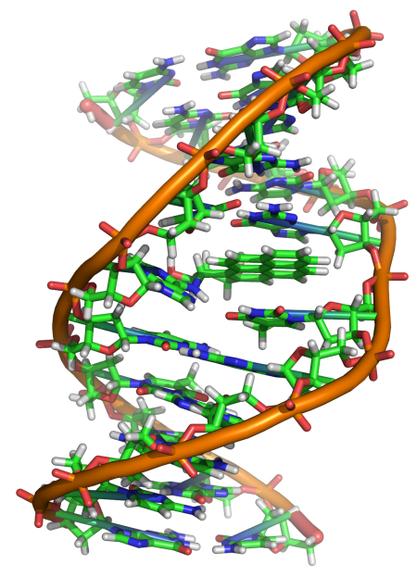
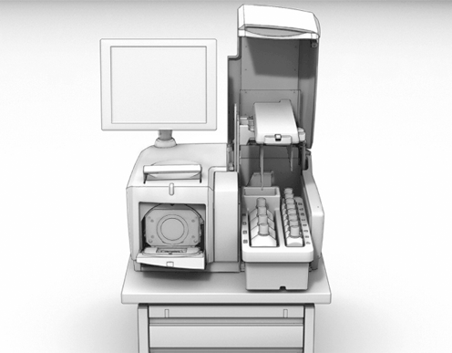
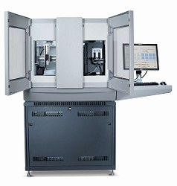
GATGCTTACTATGCGGGCCCC
CGGTCTAATGCTTACTATGC
GCTTACTATGCGGGCCCCTT
?
AATGCTTACTATGCGGGCCCCTT
TAATGCTTACTATGC
AATGCTTAGCTATGCGGGC
AATGCTTACTATGCGGGCCCCTT
AATGCTTACTATGCGGGCCCCTT
CGGTCTAGATGCTTACTATGC
AATGCTTACTATGCGGGCCCCTT
CGGTCTAATGCTTAGCTATGC
ATGCTTACTATGCGGGCCCCTT
Reads
Subject genome
Human genome: 3 gbp
A few billion short reads (~100 GB compressed data)
Sequencer

Slide 12

Business
Data-driven decisions
Data-driven products
Source: Wikiedia (Shinjuku, Tokyo)

Slide 13
Business Intelligence
An organization should retain data that result from carrying out its mission and exploit those data to generate insights that benefit the organization, for example, market analysis, strategic planning, decision making, etc.
Duh!?

Slide 14
This is not a new idea!
In the 1990s, Wal-Mart found that customers tended to buy diapers and beer together. So they put them next to each other and increased sales of both.*
So what’s changed?
More compute and storage
Ability to gather behavioral data
* BTW, this is completely apocryphal. (But it makes a nice story.)

Slide 15
Virtuous Product Cycle
a useful service
$ (hopefully)
transform insights into action
analyze user behavior to extract insights
Google.
Facebook.
Twitter.
Amazon.
Uber.
data products
data science

Slide 16

Source: https://images.lookhuman.com/render/standard/8002245806006052/pillow14in-whi-z1-t-netflixing.png

Slide 17
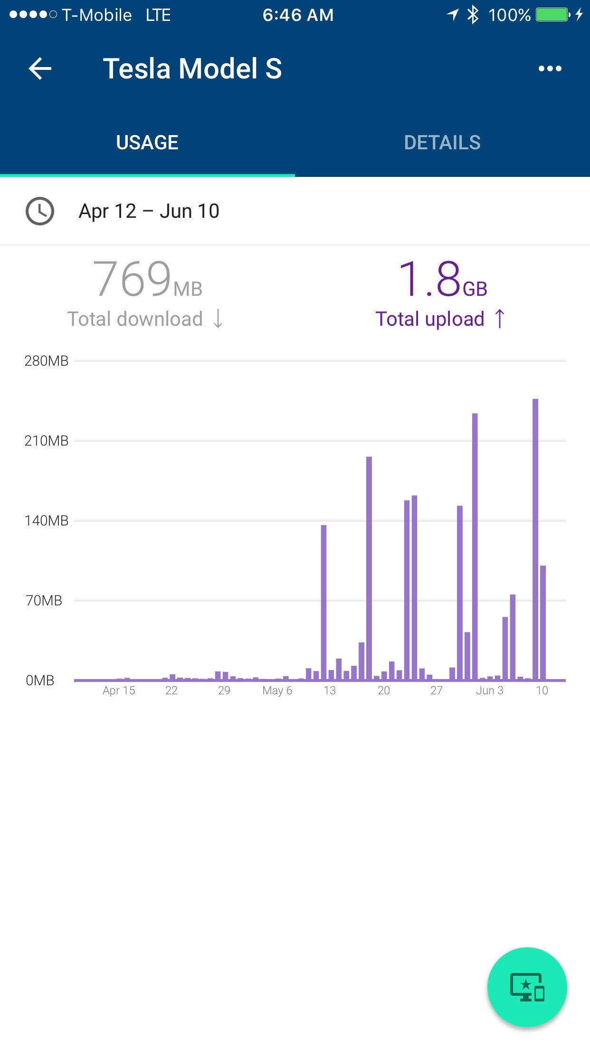
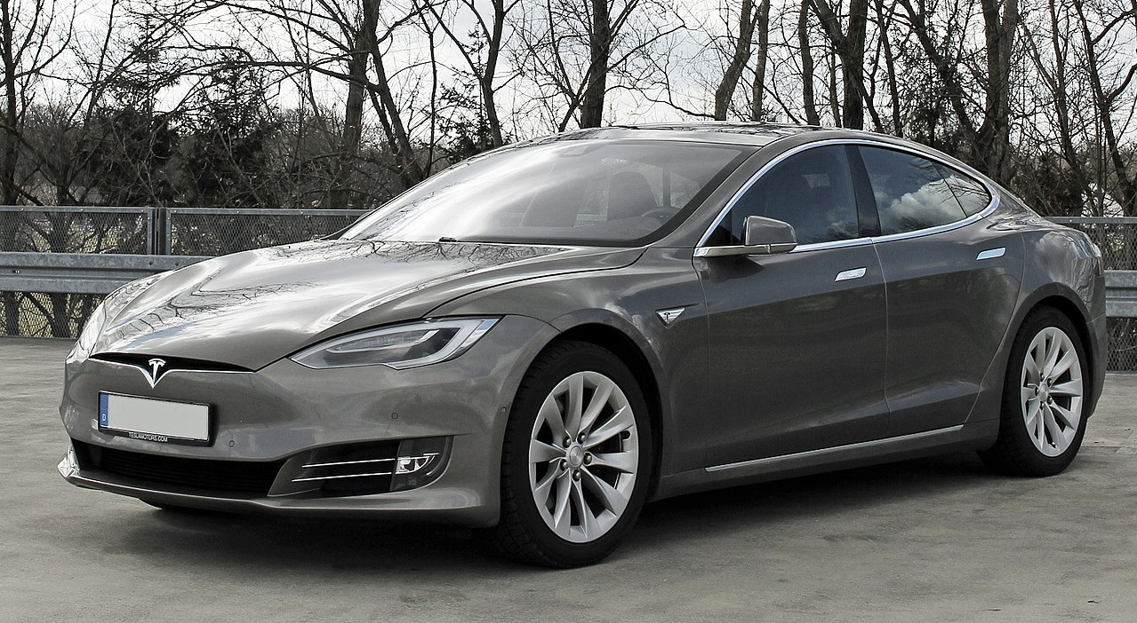
Source: https://www.reddit.com/r/teslamotors/comments/6gsc6v/i_think_the_neural_net_mining_is_just_starting/ (June 2017)

Slide 18
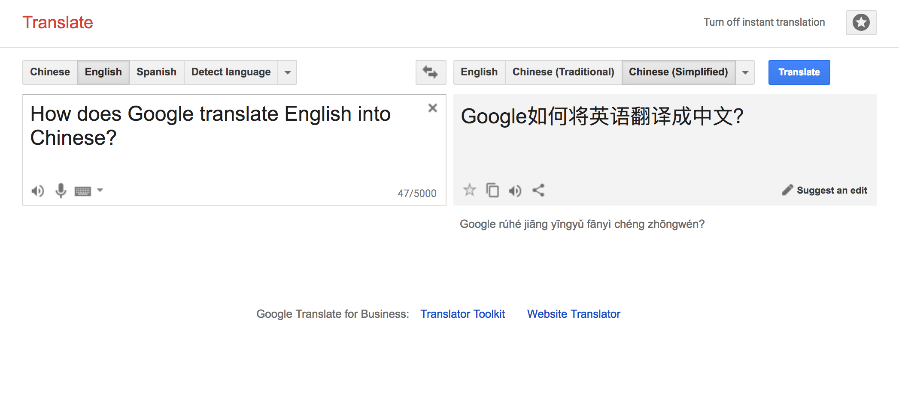

Slide 19

Source: Wikipedia (Rosetta Stone)

Slide 20
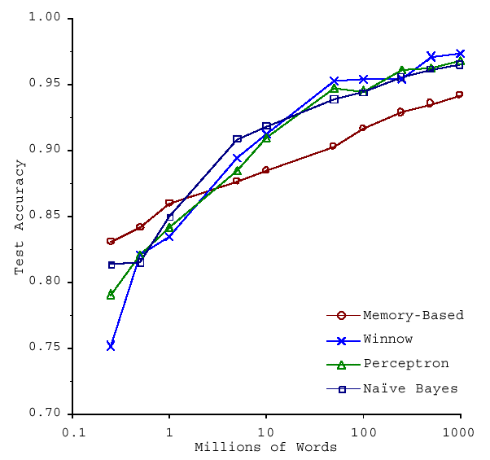
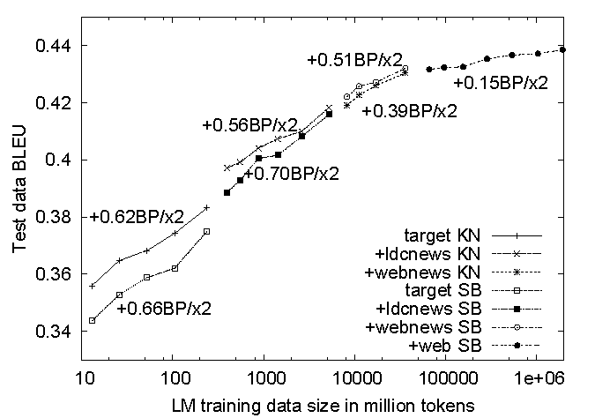
No data like more data!
(Banko and Brill, ACL 2001)
(Brants et al., EMNLP 2007)

Slide 21
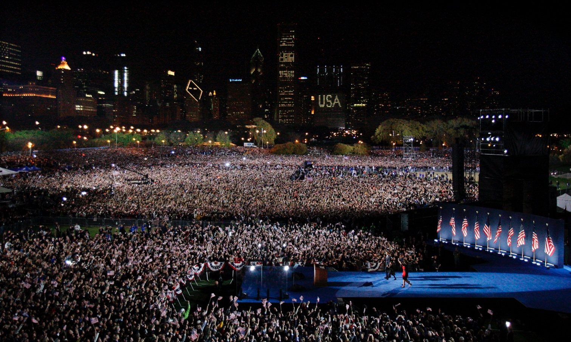
Society
Humans as social sensors
Computational social science
Source: Guardian

Slide 22
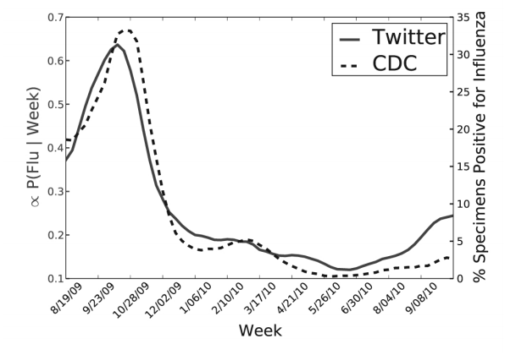

Predicting X with Twitter
2010 US Midterm Elections: 60m users shown “I Voted” Messages
Summary: increased turnout by 60k directly and 280k indirectly
Woah! You should feel unsettled about this!
Political Mobilization on Facebook
(Paul and Dredze, ICWSM 2011; Bond et al., Nature 2011)

Slide 23

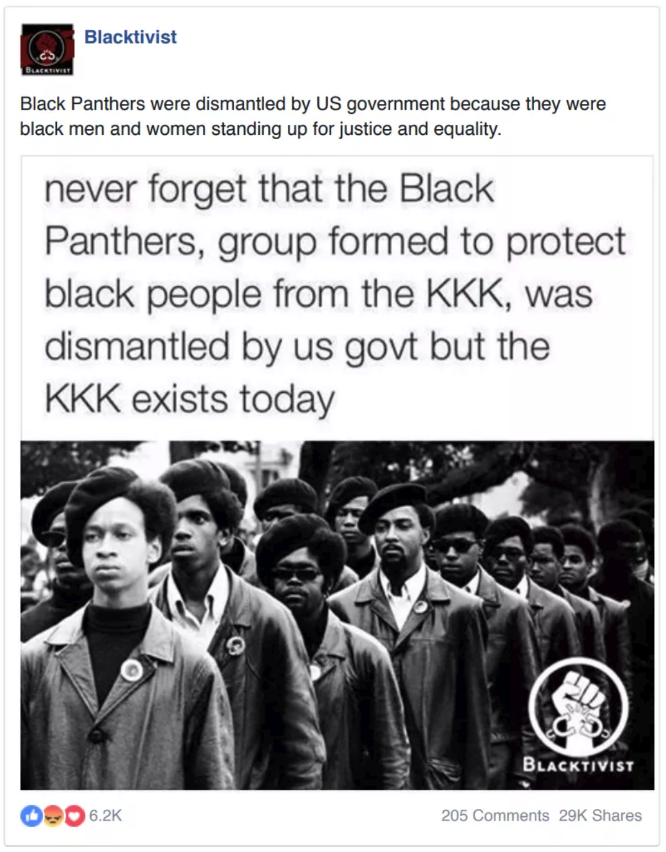


Source: https://www.theverge.com/2017/11/1/16593346/house-russia-facebook-ads

Slide 24


Source: https://www.propublica.org/article/facebook-enabled-advertisers-to-reach-jew-haters

Slide 25


Slide 26

Source: http://www.cnn.com/2016/12/07/asia/new-zealand-passport-robot-asian-trnd/index.html

Slide 27
The Perils of Big Data
The end of privacy
Who owns your data and can the government access it?
The echo chamber
Are you seeing only what you want to see?
The racist algorithm
Algorithms aren’t racist, people are?
We desperately need “data ethics” to go with big data!

Slide 28
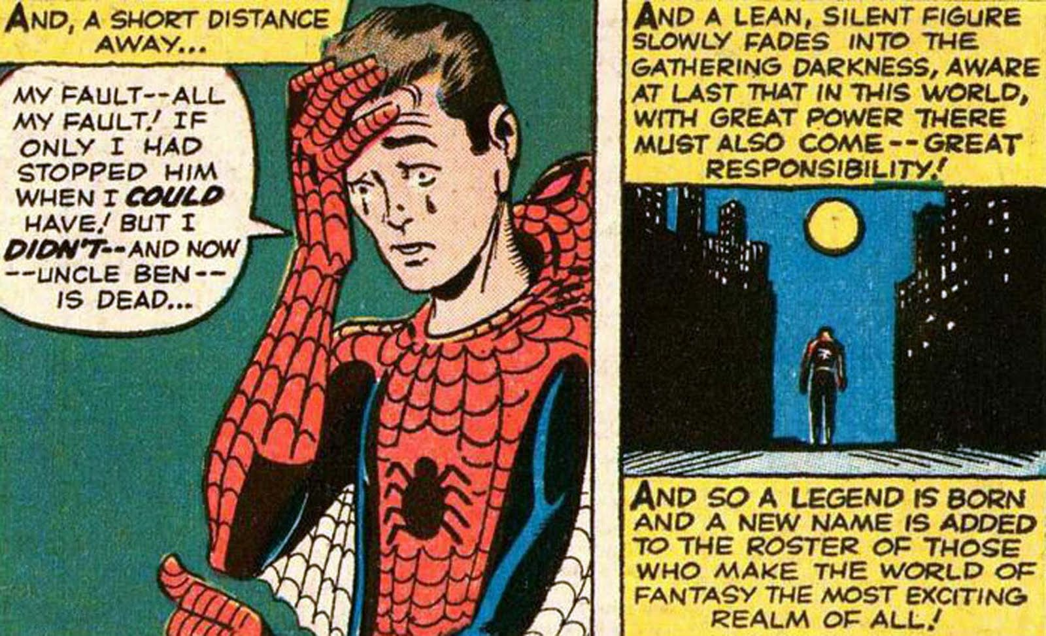

Slide 29

Source: Popular Internet Meme

Slide 30

Tackling Big Data
Source: Google

Slide 31
Logical View
k₁
v₁
k₂
v₂
k₃
v₃
k₄
v₄
k₅
v₅
k₆
v₆
map
map
map
map
a
1
b
2
c
3
c
6
a
5
c
2
b
7
c
8
combine
combine
combine
combine
a
1
b
2
c
9
a
5
c
2
b
7
c
8
partition
partition
partition
partition
group values by key
a
1
5
b
2
7
c
2
9
8
*
*
*
reduce
reduce
reduce
r₁
s₁
r₂
s₂
r₃
s₃
* Important detail: reducers process keys in sorted order

Slide 32
Physical View
User Program
(1) submit
Master
(2) schedule map
(2) schedule reduce
worker
split 0
(6) write
output
file 0
split 1
(5) remote read
worker
split 2
(3) read
(4) local write
split 3
worker
split 4
worker
output
file 1
worker
Input
files
Map
phase
Intermediate files
(on local disk)
Reduce
phase
Output
files
Adapted from (Dean and Ghemawat, OSDI 2004)

Slide 33

The datacenter is the computer!
Source: Google

Slide 34
The datacenter is the computer!
It’s all about the right level of abstraction
Moving beyond the von Neumann architecture
What’s the “instruction set” of the datacenter computer?
Hide system-level details from the developers
No more race conditions, lock contention, etc.
No need to explicitly worry about reliability, fault tolerance, etc.
Separating the what from the how
Developer specifies the computation that needs to be performed
Execution framework (“runtime”) handles actual execution

Slide 35
The datacenter is the computer!
“Big ideas”
*
Scale “out”, not “up”
Limits of SMP and large shared-memory machines
Assume that components will break
Engineer software around hardware failures
*
Move processing to the data
Cluster have limited bandwidth, code is a lot smaller
Process data sequentially, avoid random access
Seeks are expensive, disk throughput is good

Slide 36
Seek vs. Scans
Consider a 1 TB database with 100 byte records
We want to update 1 percent of the records
Scenario 1: Mutate each record
Each update takes ~30 ms (seek, read, write)
10⁸ updates = ~35 days
Scenario 2: Rewrite all records
Assume 100 MB/s throughput
Time = 5.6 hours(!)
Lesson? Random access is expensive!
Source: Ted Dunning, on Hadoop mailing list

Slide 37
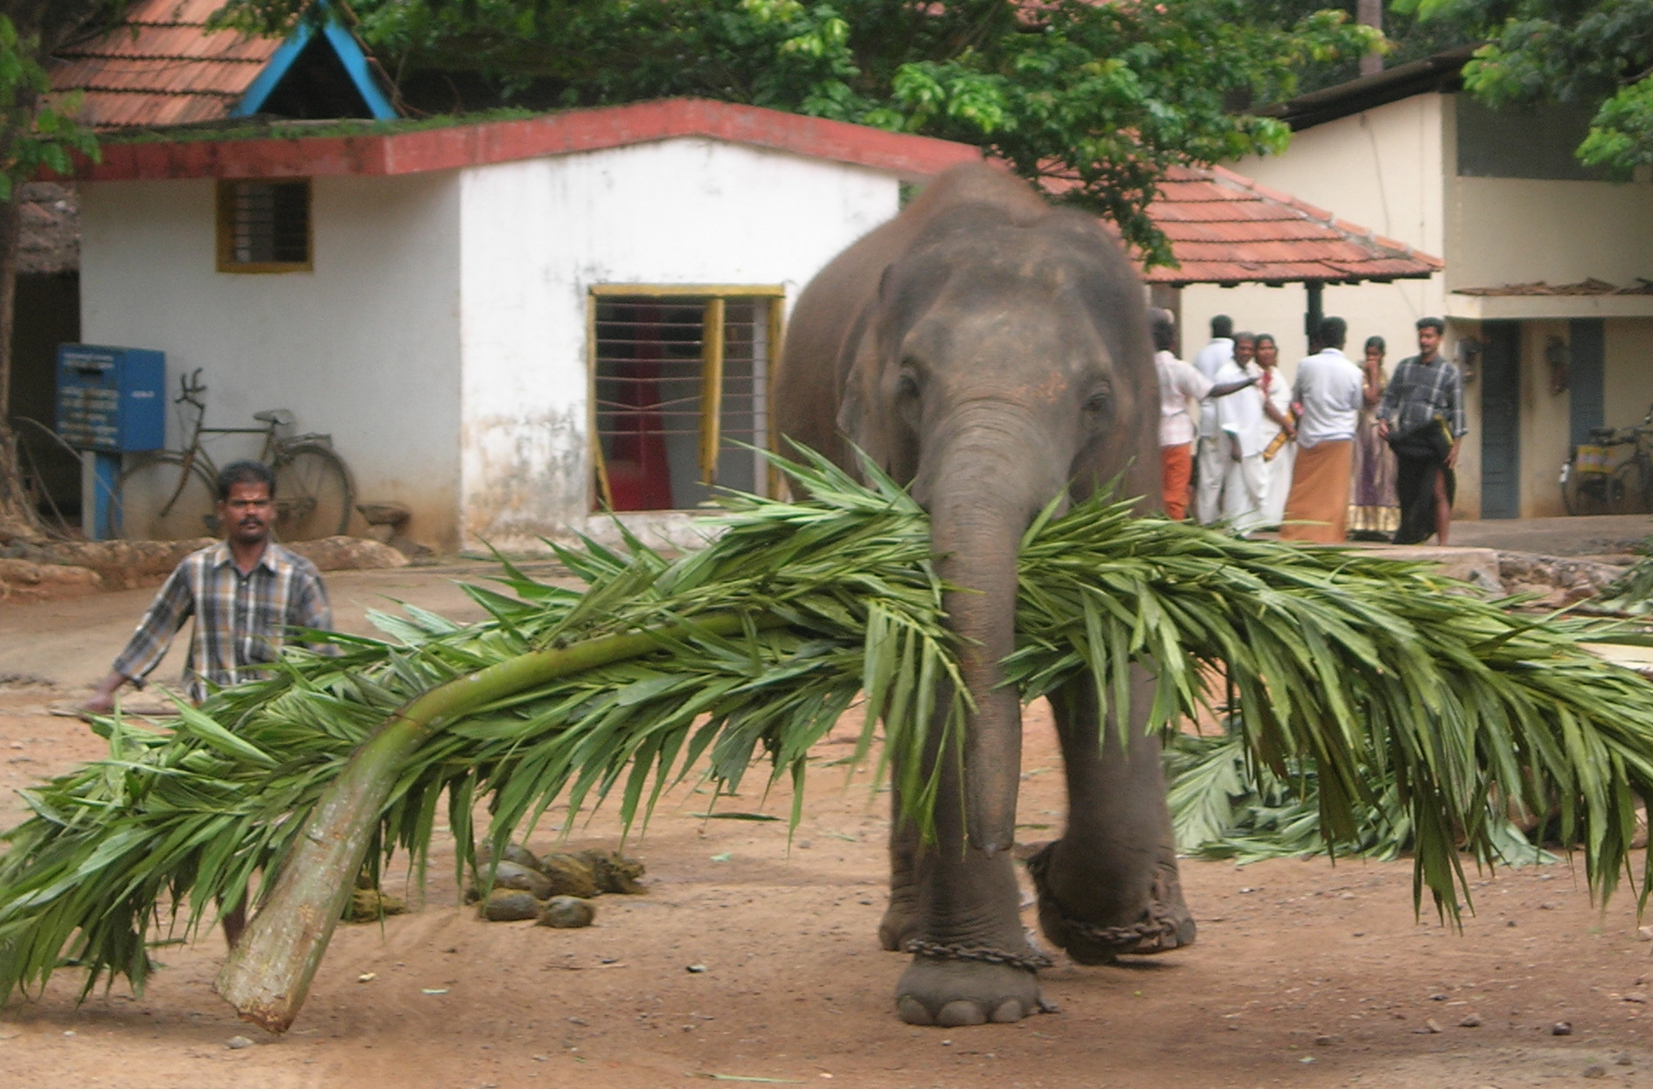

So you want to drive the elephant!
Source: Wikipedia (Mahout)

Slide 38

So you want to drive the elephant!
(Aside, what about Spark?)

Slide 39

A tale of two packages…
org.apache.hadoop.mapreduce
org.apache.hadoop.mapred
Source: Wikipedia (Budapest)

Slide 40
MapReduce API*
Mapper<K_{in},V_{in},K_{out},V_{out}>
void setup(Mapper.Context context)
Called once at the start of the task
void map(K_{in} key, V_{in} value, Mapper.Context context)
Called once for each key/value pair in the input split
void cleanup(Mapper.Context context)
Called once at the end of the task
Reducer<K_{in},V_{in},K_{out},V_{out}>/Combiner<K_{in},V_{in},K_{out},V_{out}>
void setup(Reducer.Context context)
Called once at the start of the task
void reduce(K_{in} key, Iterable<V_{in}> values, Reducer.Context context)
Called once for each key
void cleanup(Reducer.Context context)
Called once at the end of the task
*Note that there are two versions of the API!

Slide 41
MapReduce API*
Partitioner<K, V>
int getPartition(K key, V value, int numPartitions)
Returns the partition number given total number of partitions
Job
Represents a packaged Hadoop job for submission to cluster
Need to specify input and output paths
Need to specify input and output formats
Need to specify mapper, reducer, combiner, partitioner classes
Need to specify intermediate/final key/value classes
Need to specify number of reducers (but not mappers, why?)
Don’t depend of defaults!
*Note that there are two versions of the API!

Slide 42
Data Types in Hadoop: Keys and Values
Writable
Defines a de/serialization protocol. Every data type in Hadoop is a Writable.
WritableComprable
Defines a sort order. All keys must be of this type (but not values).
IntWritable LongWritable
Text
…
Concrete classes for different data types.
Note that these are container objects.
SequenceFile
Binary-encoded sequence of key/value pairs.

Slide 43
“Hello World” MapReduce: Word Count
def map(key: Long, value: String) = {
for (word <- tokenize(value)) {
emit(word, 1)
}
}
def reduce(key: String, values: Iterable[Int]) = {
for (value <- values) {
sum += value
}
emit(key, sum)
}

Slide 44
Word Count Mapper
private static final class MyMapper
extends Mapper<LongWritable, Text, Text, IntWritable> {
private final static IntWritable ONE = new IntWritable(1);
private final static Text WORD = new Text();
@Override
public void map(LongWritable key, Text value, Context context)
throws IOException, InterruptedException {
for (String word : Tokenizer.tokenize(value.toString())) {
WORD.set(word);
context.write(WORD, ONE);
}
}
}

Slide 45
Word Count Reducer
private static final class MyReducer
extends Reducer<Text, IntWritable, Text, IntWritable> {
private final static IntWritable SUM = new IntWritable();
@Override
public void reduce(Text key, Iterable<IntWritable> values,
Context context) throws IOException, InterruptedException {
Iterator<IntWritable> iter = values.iterator();
int sum = 0;
while (iter.hasNext()) {
sum += iter.next().get();
}
SUM.set(sum);
context.write(key, SUM);
}
}

Slide 46
Three Gotchas
Avoid object creation
Execution framework reuses value object in reducer
Passing parameters via class statics doesn’t work!

Slide 47
Getting Data to Mappers and Reducers
Configuration parameters
Pass in via Job configuration object
“Side data”
DistributedCache
Mappers/Reducers can read from HDFS in setup method

Slide 48
Complex Data Types in Hadoop
How do you implement complex data types?
The easiest way:
Encoded it as Text, e.g., (a, b) = “a:b”
Use regular expressions to parse and extract data
Works, but janky
The hard way:
Define a custom implementation of Writable(Comprable)
Must implement: readFields, write, (compareTo)
Computationally efficient, but slow for rapid prototyping
Implement WritableComparator hook for performance
Somewhere in the middle:
Bespin (via lin.tl) offers various building blocks

Slide 49
Anatomy of a Job
Hadoop MapReduce program = Hadoop job
Jobs are divided into map and reduce tasks
An instance of a running task is called a task attempt
Each task occupies a slot on the tasktracker
Multiple jobs can be composed into a workflow
Job submission:
Client (i.e., driver program) creates a job,
configures it,
and submits it to jobtracker
That’s it! The Hadoop cluster takes over…

Slide 50
User Program
(1) submit
Master
(2) schedule map
(2) schedule reduce
worker
split 0
(6) write
output
file 0
split 1
(5) remote read
worker
split 2
(3) read
(4) local write
split 3
worker
split 4
worker
output
file 1
worker
Input
files
Map
phase
Intermediate files
(on local disk)
Reduce
phase
Output
files
Adapted from (Dean and Ghemawat, OSDI 2004)

Slide 51
Anatomy of a Job
Behind the scenes:
Input splits are computed (on client end)
Job data (jar, configuration XML) are sent to jobtracker
Jobtracker puts job data in shared location, enqueues tasks
Tasktrackers poll for tasks
Off to the races…

Slide 52
Input File
Input File
InputSplit
InputSplit
InputSplit
InputSplit
InputSplit
InputFormat
RecordReader
RecordReader
RecordReader
RecordReader
RecordReader
Mapper
Mapper
Mapper
Mapper
Mapper
Intermediates
Intermediates
Intermediates
Intermediates
Intermediates
Source: redrawn from a slide by Cloduera, cc-licensed

Slide 53
Client
Records
…
…
InputSplit
InputSplit
InputSplit
RecordReader
RecordReader
RecordReader
Mapper
Mapper
Mapper
Where’s the data actually coming from?

Slide 54
Mapper
Mapper
Mapper
Mapper
Mapper
Intermediates
Intermediates
Intermediates
Intermediates
Intermediates
Partitioner
Partitioner
Partitioner
Partitioner
Partitioner
(combiners omitted here)
Intermediates
Intermediates
Intermediates
Reducer
Reducer
Reduce
Source: redrawn from a slide by Cloduera, cc-licensed

Slide 55
Reducer
Reducer
Reduce
OutputFormat
RecordWriter
RecordWriter
RecordWriter
Output File
Output File
Output File
Source: redrawn from a slide by Cloduera, cc-licensed

Slide 56
Input and Output
InputFormat
TextInputFormat
KeyValueTextInputFormat
SequenceFileInputFormat
…
OutputFormat
TextOutputFormat
SequenceFileOutputFormat
…
Spark also uses these abstractions for reading and writing data!

Slide 57

Hadoop Workflow
Submit node
(datasci)
Hadoop Cluster
You
Getting data in?
Where’s the actual data stored?
Writing code?
Getting data out?

Slide 58
Debugging Hadoop
First, take a deep breath
Start small, start locally
Build incrementally

Slide 59

Source: Wikipedia (The Scream)

Slide 60
Code Execution Environments
Different ways to run code:
Local (standalone) mode
Pseudo-distributed mode
Fully-distributed mode
Learn what’s good for what

Slide 61
Hadoop Debugging Strategies
Good ol’ System.out.println
Learn to use the webapp to access logs
Logging preferred over System.out.println
Be careful how much you log!
Fail on success
Throw RuntimeExceptions and capture state
Use Hadoop as the “glue”
Implement core functionality outside mappers and reducers
Independently test (e.g., unit testing)
Compose (tested) components in mappers and reducers

Slide 62

Questions?
Source: Wikipedia (Japanese rock garden)

